Slide 1
A Systems Engineering Based Senior Project
Senior Design Project
Digitally Controlled Audio Filter + FFT Analyzer
(DCAFF)
Ramiro Carrillo (rcarr026@ucr.edu)
Henry Chen (hchen217@ucr.edu)
Michael Tang (mtang014@ucr.edu)
Jeffrey Lee (jlee395@ucr.edu)
February 24th, 2020

Slide 2
Concept and Application
Create an audio device for frequency filtering.
Filter signal through Nth order IIR Butterworth Filter (low, high, and bandpass)
Display the FFT of the filtered and original signal
Create a user-friendly interface for novice and professionals
Technical Principles, signal processing, embedded systems, circuit design
Create an add-on Class D Amplifier module that will amplify and output an audio signal via an in-built speaker

Slide 3
System Engineering Topics Used in Project
Statement of Work (SOW), Cost Estimating, Project Management
Reviews (PMRs), Bill of Material (BOM), Project “Gantt chart
Functional Architecture/Allocation, System Architecture, Concept of Operation (CONOP)
Gate Reviews: System Requirement Review (SRR), Preliminary
Design Review (PDR), Critical Design Review (CDR)
System Requirement Document (SRD), Requirement Verification
Matrix, Test Plan, Test Procedure, Test Report, Configuration
Control, Interface Control Document (ICD)
Risk Analysis and Mitigation, Independent Review Team (IRT)
Quality Assurance (QA), Integration and Test (I&T)

Slide 4
Technical Design Objectives
DAC and ADC Sampling rate of 44.1kHz and 16 bit samples (CD quality).
Takes in a 0-20 KHz Audio Signal (audible spectrum)
Serial communication between microcontroller and PC (9600 baud rate).
Filters a Audio Signal through a corresponding Low, High, or BandPass Nth order Butterworth Filter with the frequency being 95% accurate of it’s original frequency.
The number of samples in the FFT for a certain frequency should be within 90% of the expected sample rate
Class D Amplifier will use a 12-volt power source to generate 10 watts per channel
Filters will have adjustable cutoff frequency from 0 Hz to 20 kHz a output power of around 10 watts
Class D Amplifier should have a 10 to 5 percent power loss and an efficiency at 90 percent or higher

Slide 5
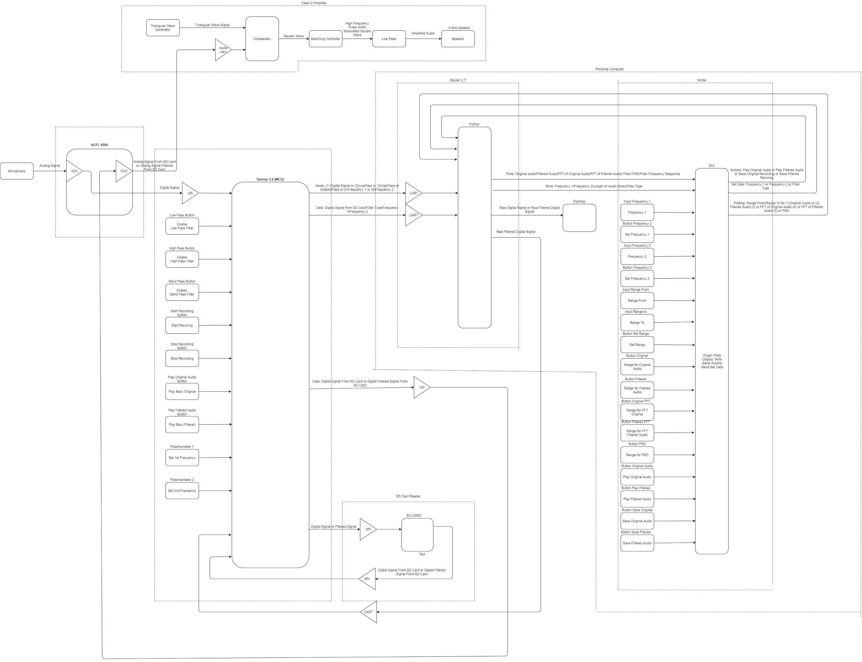
System Block Diagram
Final high-level design, show block diagram of the system.

Slide 6
Technical Challenges
-Originally used AtMega 1284 and Arduino uno for audio sampling. Could only sample up to 20 kHz at 8-bits per samples. Needed 44.1Khz sampling rate and 16-bit sample lengths for decent quality.
-Various communications with multiple subsystems (DAC(I2S), ADC(I2S), SD card(SPI), PC(UART)).
-Designing the Nth order Butterworth Filter.
-Audio formatting into a 16 bit PCM raw file (bit manipulation)
-Integrating 3 concurrent state machines
-Comparator not outputting the right values
-Originally used different Class D Amplifier schematic. Could not output an audio signal from speaker
-4 Ohm Speaker is too quiet

Slide 7
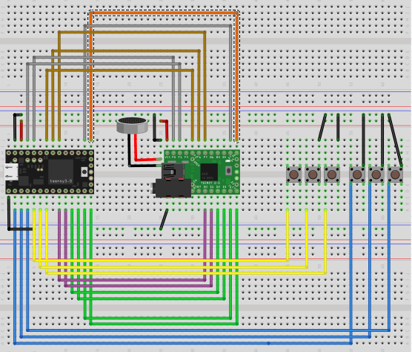
Major Components
Microphone and MCU
Legend
Yellow: Low, High, Band Pass Filters
Blue: Record, Stop Recording, Play Recording
Green: Save Recording to SD Card
Purple: SPI Communication in and out
Brown: I2S Communication In from Teensy
Grey: I2S Communication Out from Teensy
Orange: I2S ready to send/receive
Black: Ground
Red: 3.3 V

Slide 8
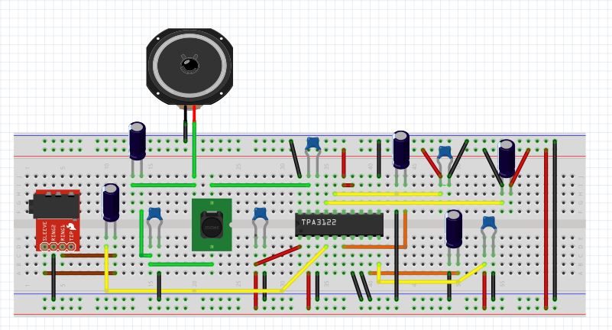
Major Components(2)
Class D Audio Amplifier
Legend
Yellow: Input into TPA3122
Green: Low and High Pass Filters
Brown: Audio Signal Input from Audio Jack
Orange: High Pass output to reduce high frequency
Black: Ground
Red: 12 V

Slide 9
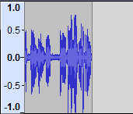
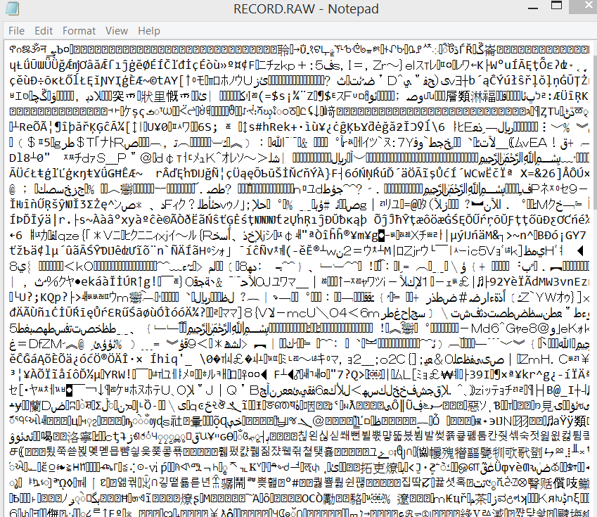
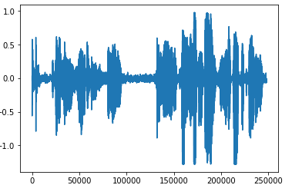
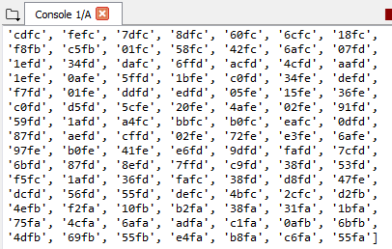
Test Report(2)
Audacity
Vs.
Our reproduction
Serial Communication Test
Audio formatting
Turn this...
Into 16 bit data!

Slide 10
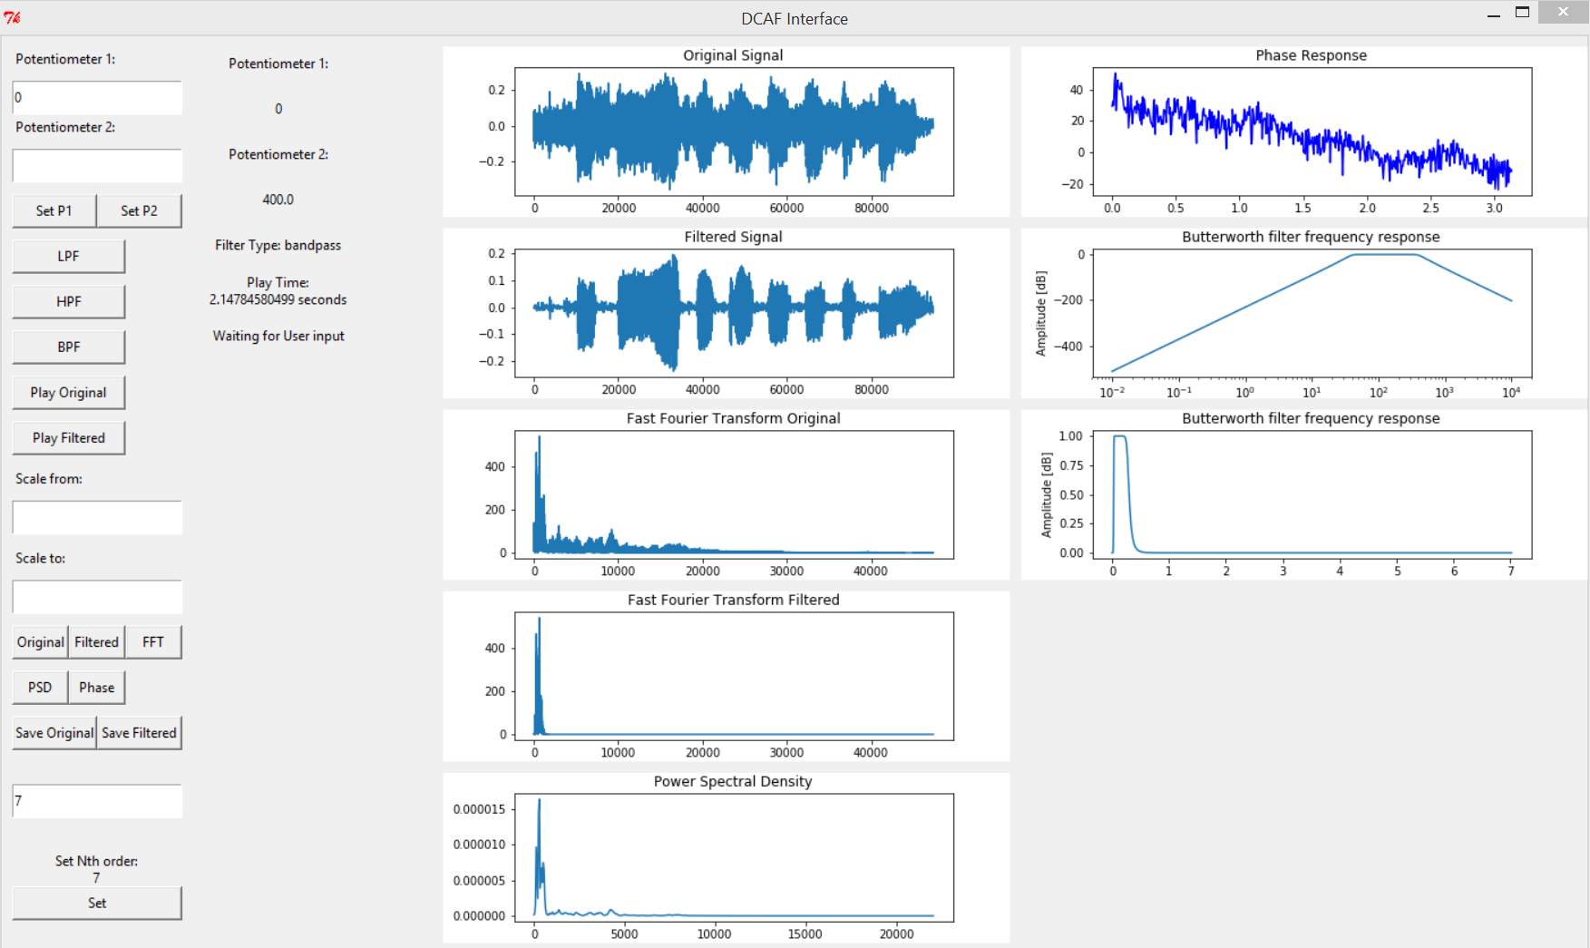

Test: Noise Reduction Test
Original
Filter

Slide 11
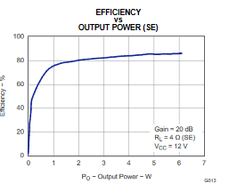
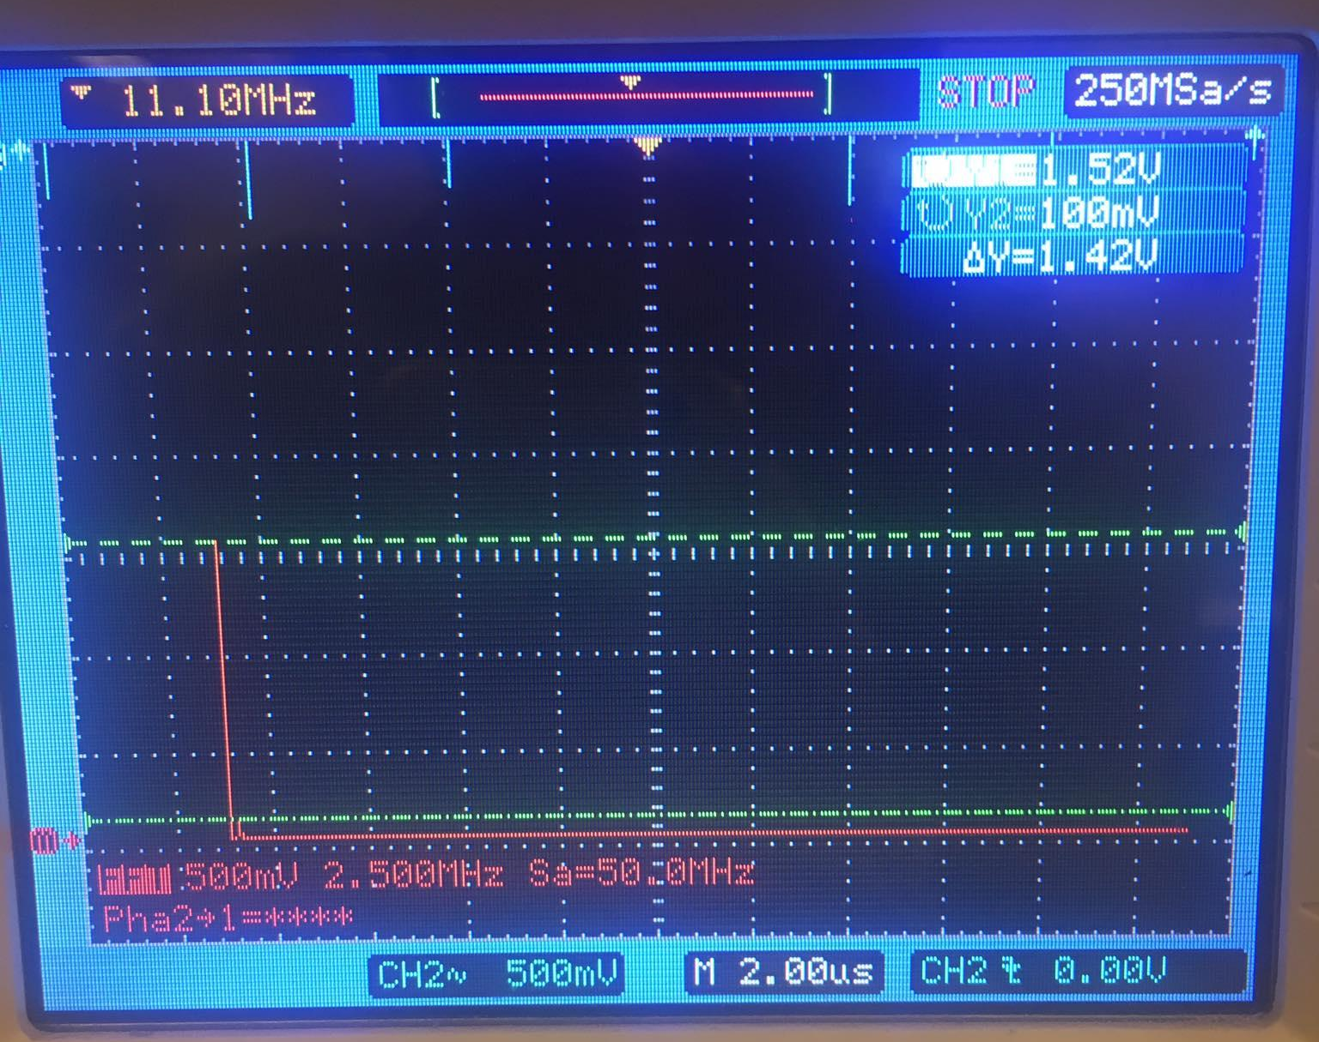
Class D Test: Power Efficiency
Test Report
Of all of the Class D Audio Amplifier tests, Power Efficiency is the most important. To distinguish this Class D Amplifier from other audio amplifiers, this amplifier must have a power efficiency of 90 percent or above. The other tests determine sound distortion and sound delay.
Figure 1: Power Efficiency Results (Over 90 percent efficiency)
Figure 2: Harmonic Distortion Results (Small Distortion)

Slide 12
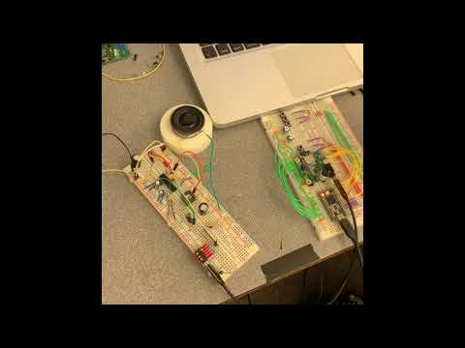
Demonstration
Original Video:
https://www.youtube.com/watch?v=iTVZIgoqJM8
Demo Only Video:
https://www.youtube.com/watch?v=r6Y7n5dhvUg

Slide 13
Summary
DCAFF can record a 0-20Hz audio signal with a 44.1K sampling rate at 16-bits per samples. It is able to successfully filter signals through an Nth order Butterworth filter, and display the FFT of the original and filtered signal. DCAFF can then output the filtered signal through a class D amplifier.
DCAFF can be applied in a professional setting or be used by a novice.

Slide 14
Acknowledgements
Paul (Created Teensy)
Youtuber GreatScott! (Class D Amplifier Design Concept and Ideas)
Roman Chomko(EE110b slides)
Youtuber Afrotechmods (Class D Amplifier Schematic and Class D Amplifier Design Concept)

